Slide 1
Chapter 7

Slide 2

Topics
General tree structure and the Tree ADT
Tree traversal algorithms
Binary trees

Slide 3
Binary Trees
A list, stack, or queue is a linear structure that consists of a sequence of elements
A binary tree is a hierarchical structure

Slide 4
Example of a Tree
Make Money Fast!
Stock Fraud
Ponzi Scheme
Bank Robbery

Slide 5
What is a Tree?
In computer science, a tree is an abstract model of a hierarchical structure
A tree consists of nodes with a parent-child relation
Applications:
Organization charts
File systems
Programming environments
Computers”R”Us
Sales
Manufacturing
R&D
US
International
Laptops
Desktops
Europe
Asia
Canada

Slide 6
Tree Terminology
Root: node without parent (A)
Internal node: node with at least one child (A, B, C, F)
External node (a.k.a. leaf ): node without children (E, I, J, K, G, H, D)
Ancestors of a node: parent, grandparent, grand-grandparent, etc.
Depth of a node: number of ancestors
Height of a tree: maximum depth of any node (3)
Descendant of a node: child, grandchild, grand-grandchild, etc.
Subtree: tree consisting of a node and its descendants
A
subtree
B
C
D
E
F
G
H
I
J
K

Slide 7
More Tree Terminology
Siblings are two nodes that are children of the same parent (I,J)
An edge of a tree is a pair of nodes (u,v) such that u is the parent of v, or vice versa (F,K)
A path of a tree is a sequence of nodes such that any two consecutive nodes in the sequence form an edge (A,B,F,K)
The level of a tree is the set of all nodes at the same depth
A
subtree
B
C
D
E
F
G
H
I
J
K

Slide 8
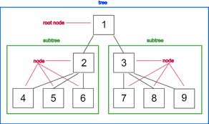
Ordered Trees
A tree is ordered if there is a linear ordering defined for children of each node
Children of a node can be identified as being first, second, third, etc.
Visualized by arranging siblings from left to right
Example: A book/chapters/sections

Slide 9

Tree ADT
The Tree ADT stores elements at the nodes of trees
Each node is associated with a position object (terms are used interchangeably)
Provides access to the nodes
Given a position p, *p accesses the elements
Nodes cannot be accessed directly
p (positions) rather than v (vector objects) are used as arguments to the Tree ADT methods
Position list
List of elements that are tree positions

Slide 10

Tree ADT Methods
Given position p and tree T
p.parent(): returns the parent of p: error occurs if p is the root
p.children(): returns a position list containing the children of node p
If T is ordered, then the children are returned in order
p.isRoot(): returns true if p is the root otherwise false
p.isExternal(): returns true if p is external otherwise false

Slide 11

Tree ADT Generic Methods
size():
Returns the number of nodes in the tree
empty():
Tests whether the tree has any nodes
positions():
Returns a position list of all the nodes in the tree
root():
Returns a position for the tree’s root, an error occurs if the tree is empty

Slide 12

Position Class Interface
template <typename E> // base element type
class Position<E> { // a node position
public:
E& operator*(); // get element
Position parent() const; // get parent
PositionList children() const; // get node's children
bool isRoot() const; // root node?
bool isExternal() const; // external node?
};
7.1

Slide 13
Tree Interface
template <typename E> // base element type
class Tree<E> {
public: // public types
class Position; // a node position
class PositionList; // a list of positions
public: // public functions
int size() const; // number of nodes
bool empty() const; // is tree empty?
Position root() const; // get the root
PositionList positions() const; // get positions of all nodes
};
PositionList – is a <list> STL
Provides an iterator type (called Iterator)
Note:
A class can be declared within the scope of another class
Called a "nested class"
Nested classes are considered to be within the scope of the enclosing class and are available for use within that scope
To refer to a nested class from a scope other than its immediate enclosing scope, one must use a fully qualified name
7.2

Slide 14
Linked Structure for General Trees
A tree can be viewed as a linked structure where each node as the following format
Children container (List or an array to store links to the children)
parent
element

Slide 15
Linked Structure for Trees
A node is represented by an object storing
Element
Parent node
Sequence of children nodes
Node objects implement the Position ADT
B
∅
A
∅
D
F
∅
B
A
D
F
C
E
C
∅
E
∅

Slide 16

Performance of the Linked Structure
Method | Time
isRoot(), isExternal() | O(1)
parent() | O(1)
children() | O(c_{p})
size(), empty() | O(1)
root() | O(1)
positions() | O(n)
Where c_{p} is the number of children of p

Slide 17
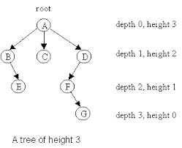
Depth of a Node
The depth of a node p in a tree T is defined as
Number of ancestors excluding p itself
If v is the root, then its depth is 0;
Otherwise, its depth of p is one plus the depth of its parent

Slide 18

Determining the Depth of a Node using Recursion
int depth(const Tree& T, const Position& p) {
if (p.isRoot())
return 0; // root has depth 0
else
return 1 + depth(T, p.parent());// 1 + (depth of parent)
}
7.4
Running time is O(d_{p}) where d_{p} denotes the depth of the tree

Slide 19

Height of a Node
The height of a node p in a tree T is defined as
Maximum depth of any node
The height of a nonempty tree T is equal to the maximum depth of an external (a.k.a. leaf) node of T

Slide 20

Recursive Height Algorithm
int height2(const Tree& T, const Position& p) {
if (p.isExternal()) return 0;// leaf has height 0
int h = 0;
PositionList ch = p.children(); // list of children
for (Iterator q = ch.begin(); q != ch.end(); ++q)
h = max(h, height2(T, *q));
return 1 + h; // 1 + max height of children
}
7.8

Slide 21

Binary Trees

Slide 22
Binary Trees
A binary tree is an ordered tree with the following properties
Each node has at most two children
Each child node is labeled as being either a left or right child
A left child precedes a right child in the ordering of the children of the node
The subtree rooted at a left or right child is called a left subtree or right subtree respectively
Applications:
Arithmetic expressions
Decision processes
Searching
A
B
C
D
E
F
G
H
I

Slide 23
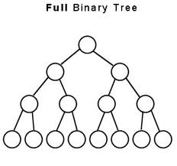
More on Binary Trees
A binary tree is proper (or full) if each node has either zero or two children
Every internal node has exactly two children

Slide 24
Decision Tree
Binary tree can be associated with a decision process
Internal nodes: questions with yes/no answer
External nodes: decisions
Example: dining decision
Want a fast meal?
Yes
No
How about coffee?
On expense account?
Yes
No
Yes
No
Starbucks
Subway
Five Crowns
Outback

Slide 25
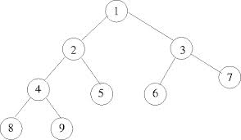
Recursive Binary Tree Definition
Binary tree is empty or consists of
A node r, called the root of T and storing an element
A binary tree, called the left subtree
A binary tree, called the right subtree

Slide 26
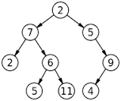
BinaryTree ADT Methods (1)
Each node of the tree stores an element and is associated with a pointer object
p.left()
Returns the left child; errors if p is an external node
p.right()
Returns the right child; errors if p is an external node
p.parent()
Returns the parent of p: error occurs if p is the root
p.isRoot()
Returns tree if p is the root otherwise false

Slide 27
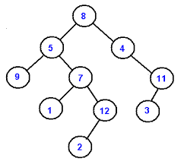
BinaryTree ADT Methods (2)
p.isExternal()
Returns tree if p is external otherwise false
size()
Returns the number of nodes in the tree
empty()
Tests whether the tree has any nodes
positions()
Returns a position list of all the nodes in the tree
root ()
Returns a position for the tree’s root, an error occurs if the tree is empty

Slide 28
Updated Position Class Interface
template <typename E> // base element type
class Position<E> { // a node position
public:
E& operator*(); // get element
Position left() const; // get left child
Position right() const; // get right child
Position parent() const; // get parent
bool isRoot() const; // root of tree?
bool isExternal() const; // an external node?
};
7.15
PositionList children() const; // replaced by the left () and right () methods

Slide 29
BinaryTree Interface
template <typename E> // base element type
class BinaryTree<E> { // binary tree
public: // public types
class Position; // a node position
class PositionList; // a list of positions
public: // member functions
int size() const; // number of nodes
bool empty() const; // is tree empty?
Position root() const; // get the root
PositionList positions() const; // list of nodes
};
7.16
PositionList – is a <list> STL
Provides an iterator type (called Iterator)

Slide 30
Properties of Binary Trees
Proposition 7.10
Properties
h + 1 ≤ n ≤ 2^{h+1} - 1
1 ≤ n_{e} ≤ 2^{h}
h ≤ n_{i} ≤ 2^{h} - 1
log(n+1)-1 ≤ h ≤ n-1
Also, if T is proper
2h + 1 ≤ n ≤ 2^{h+1} - 1
h +1 ≤ n_{e} ≤ 2^{h}
h ≤ n_{i} ≤ 2^{h} - 1
log(n+1) -1 ≤ h ≤ (n-1)/2
Notation
n - number of nodes
n_{e} - number of external nodes
n_{i} - number of internal nodes
h - height

Slide 31
Relationship Between Internal and External Nodes
In a nonempty proper binary tree, the number of external nodes is one more than the number of internal nodes
n_{e} = n_{i} +1
Level
Nodes
0
1
1
2
2
4
Proposition 7.11

Slide 32
A Linked Structure of Binary Trees
A tree can be viewed as a linked structure where each node has the following format
The number of nodes is stored in a variable called size
parent
left
right
Element
(can be a pointer or an object)

Slide 33
Linked Structure for Binary Trees
A node is represented by an object storing
Element
Parent node
Left child node
Right child node
Node objects implement the Position ADT
∅
B
∅
∅
A
D
B
A
D
∅
∅
∅
∅
C
E
C
E
See code fragments 7.17 to 7.23

Slide 34
LinkedBinary Tree
typedef int Elem; // base element type
class LinkedBinaryTree {
protected:
// insert Node declaration here...
public:
// insert Position declaration here...
public:
LinkedBinaryTree(); // constructor
int size() const; // number of nodes
bool empty() const; // is tree empty?
Position root() const; // get the root
PositionList positions() const; // list of nodes
void addRoot(); // add root to empty tree
void expandExternal(const Position& p); // expand external node
Position removeAboveExternal(const Position& p); // remove p and parent
// housekeeping functions omitted...
protected: // local utilities
void preorder(Node* v, PositionList& pl) const; // preorder utility
private:
Node* _root; // pointer to the root
int n; // number of nodes
};
7.19

Slide 35
Performance of Linked Binary Tree
Method | Time
left, right, parent, isExternal, isRoot | O(1)
expandExternal, removeAboveExternal | O(1)
size(), empty() | O(1)
root() | O(1)
positions() | O(n)

Slide 36
Vector-Based Representation of Binary Trees
Nodes are stored in an vector A
1
A
A
B
D
…
G
H
…
2
3
0
1
2
3
10
11
B
D
node p is stored at A[rank(v)]
rank(root) = 1
if node is the left child of parent(node), rank(node) = 2 ⋅ rank(parent(node))
if node is the right child of parent(node), rank(node) = 2 ⋅ rank(parent(node)) + 1
4
5
6
7
E
F
C
J
10
11
G
H

Slide 37
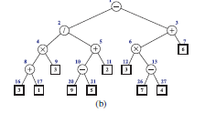
A Vector-Based Structure of Binary Trees
Figure 7.16
The vector based implementation is fast and easy but the space inefficient of the height is large

Slide 38
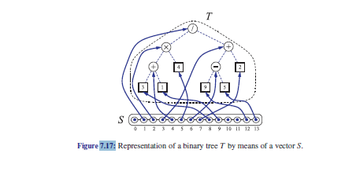
A Vector-Based Structure of Binary Trees Example

Slide 39
A Vector-Based Structure of Binary Trees
Let n be the number of nodes of a binary tree T
Let f_{M} be the maximum value of f(v) or rank(v) over all the nodes of T
The vector will have size N = f_{M} +1 since the element at index 0 is not associated with any node of T
The vector will have, in general, a number of empty elements that do not refer to existing nodes of T
For a tree of height h, N=O(2^{h})
In the worst case, this can be as high as 2^{n} - 1

Slide 40
Array-Based Representation of Binary Trees
Nodes can be stored in an extendable array or a vector
…
Implementation is simple and efficient using root(), parent(), left(), right(), hasLeft(), hasRight(), isInternal(), isExternal(), and isRoot()

Slide 41
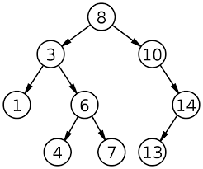
Binary Search Trees
A binary search tree is a binary tree storing keys (or key-value entries) at its internal nodes and satisfying the following property:
Let u, v, and w be three nodes such that u is in the left sub-tree of v and w is in the right sub-tree of v We have key(u) ≤ key(v) ≤ key(w)

Slide 42
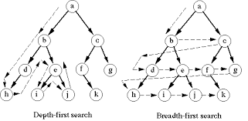
Tree Traversal Algorithms

Slide 43
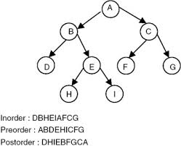
Tree Traversal
Tree traversal is the process of visiting each node in the tree exactly once
There are several ways to traverse a tree.
Preorder, postorder, in-order, depth-first, and breadth-first traversals

Slide 44
Preorder Traversal
A traversal visits the nodes of a tree in a systematic manner
In a preorder traversal, a node is visited before its descendants
Application: print a structured document
Algorithm preOrder(v)
visit(v)
for each child w of v
preorder (w)
1
Make Money Fast!
2
5
9
1. Motivations
2. Methods
References
3
4
6
7
8
2.1 Stock Fraud
2.2 Ponzi Scheme
2.3 Bank Robbery
1.1 Greed
1.2 Avidity
The depth-first is the same as the preorder

Slide 45
Another Preorder Example
1
2
7
3
4
8
9
5
6

Slide 46
Postorder Traversal
In a postorder traversal, a node is visited after its descendants
Application: compute space used by files in a directory and its subdirectories
Algorithm postOrder(v)
for each child w of v
postOrder (w)
visit(v)
9
CS1D
8
3
7
homeworks/
programs/
todo.txt 1K
1
2
4
5
6
h1c.doc 3K
h1nc.doc 2K
DDR.cpp 10K
Stocks.cpp 25K
Robot.cpp 20K

Slide 47
Inorder Traversal
In an inorder traversal a node is visited after its left subtree and before its right subtree
Application: draw a binary tree
x(v) = inorder rank of v
y(v) = depth of v
Algorithm inOrder(v)
if ¬ v.isExternal()
inOrder(v.left())
visit(v)
if ¬ v.isExternal()
inOrder(v.right())
6
2
8
1
4
7
9
3
5

Slide 48
Inorder Traversal Example
58
42
70
38
50
68
72
47
52
Inorder traversals of the internal nodes visit the elements in non-decreasing order (38,42,47,50,52,58,68,70,72)

Slide 49
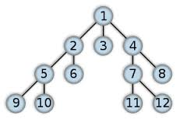
Breadth-First Tree Traversals
The breadth-first traversal is to visit the nodes level by level
First visit the root, then all children of the root from left to right, then grandchildren of the root from left to right, and so on

Slide 50
Tree Traversal Example
60
55
100
45
57
67
107
59
101
The inorder is 45 55 57 59 60 67 100 101 107
The postorder is 45 59 57 55 67 101 107 100 60
The preorder is 60 55 45 57 59 100 67 107 101
The breadth-first traversal is 60 55 100 45 57 67 107 59 101

Slide 51
Another Traversal Example
33
22
55
13
34
height 2
Inorder 13 22 33 34 55
Preorder 33 22 13 55 34
Postorder 13 22 34 55 33
breadth-first 33 22 55 13 34

Slide 52
Arithmetic Expression Tree
Binary trees are associated with an arithmetic expression
internal nodes: operators
external nodes: operands
Example: arithmetic expression tree for the expression
(2 × (a - 1) - (3 × b))
−
Inorder traversal
×
×
2
−
3
b
a
1

Slide 53
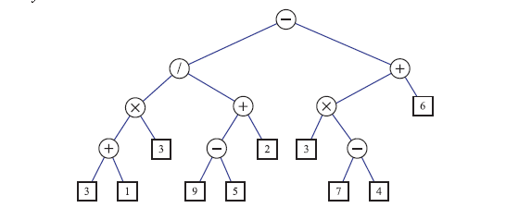
Another Arithmetic Expression Tree
Inorder traversal

Slide 54

Traversal Performance
The time complexity for the inorder, preorder, and postorder is O(n), since each node is traversed only once
See Binary Tree Code Fragments 7.15 – 7.23

Slide 55

Binary Search Tree
A binary search tree (BST), T, has these properties
Each internal node p stores an element denoted by x(p)
For each internal node p of T, the elements stored in the left sub-tree are less than or equal to x(p)
The elements stored in the right sub-tree of p are greater than or equal to x(p)
The external nodes do not store any elements
An in-order traversal of the internal nodes of a BST visits the elements in non-decreasing order

Slide 56
Searching
To search for a key k, one traces a downward path starting at the root
The next node visited depends on the outcome of the comparison of k with the key of the current node
If we reach a leaf, the key is not found and we return null
Example: find(4)
<
6
2
>
9
1
4
=
8

Slide 57
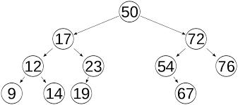
Searching for an Element
Start with the root and scan down from the root until a match is found or arrive at an empty tree
boolean search(E element){
BST<E> myBST;
current = root; // start from the root
while (current != null)
if (element < current.element) {
current =current.left://go left
}
else if (element > current.element) {
current =current.right //go right
}
else // element matches the current element
return true;
return false;
}

Slide 58

BST Performance
The performance for search is proportional to the height of the tree
In the worst case, the operations run in O(n) if n is the height of the tree

Slide 59
Performance of a BST - 2
worse case – no better than a list or array implementation - O(n)
Assume n nodes and a height of h
The height h is n in the worst case and log n in the best case
Let h be the height of a tree storing n keys
Since there are 2^{i} keys at depth i = 0, … , h - 1 and at least one key at depth h, we have n ≥ 1 + 2 + 4 + … + 2h-1 + 1 =2^{h}-1+1 (geometric sum) = 2^{h}
Taking the log of both sides of n ≥ 2^{h} => h ≤ log n
Best case is O(log n)

Slide 60
Euler Tour Traversal of a Binary Tree
+
L
×
R
×
B
2
−
3
2
5
1

Slide 61
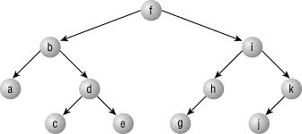
Tree Traversals
During the in-order, postorder, preorder, breadth first traversals
Nodes are visited only once

Slide 62
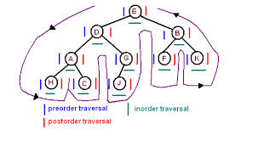
Euler Tour Traversal
Generic traversal of a binary tree
Includes special cases of the preorder, postorder and inorder traversals
Allows for more general kinds of algorithms to be expressed easily

Slide 63
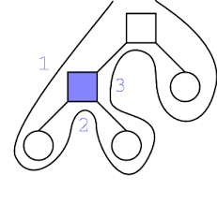
Euler Tour Traversal
Walks around the tree and visit each node three times:
On the left
Before the Euler tour of p’s left tree – preorder
From below
Before the Euler tour of p’s two subtrees- inorder
On the right
After the Euler tour of p’s right tree – postorder
If p is external, the three visits happen simultaneously

Slide 64
Euler Tour Traversal
Algorithm eulerTour(T,p);
Perform the action for visiting node p on the left
if p is internal then
recursively tour the left subtree of p by calling eulerTour(T,p.left())
Perform the action for visiting node p from below
if p is internal then
recursively tour the right subtree of p by calling eulerTour(T,p.right())
Perform the action for visiting node p on the right
7.28

Slide 65
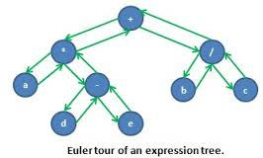
Application of Euler Tour Traversal
Print fully parentheses arithmetic expressions
On the left action
If the node is internal print “(“
From below
Print operand or operator stored at the node
On the right action
If the node is internal print “)“

Slide 66
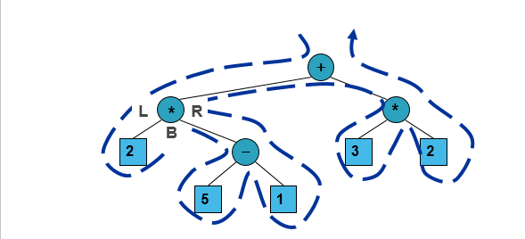
Application of Euler Tour Traversal – Arithmetic Expression
((2*(5-1))+(3*2))

Slide 67
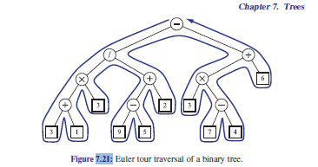
Euler Traversal of a Binary Tree
What is the value of this expression?
Inorder traversal

Slide 68
Application of Euler Tour Traversal
Algorithm printExpression(v)
if ¬v.isExternal() print(“(’’)
inOrder(v.left())
print(v.element())
if ¬v.isExternal()
inOrder(v.right())
print (“)’’)
7.29

Slide 69

Another Application of Euler Tour Traversal
Can determine the number of descendents of a node p

Slide 70
Representing General Tree with Binary Trees
For an ordered tree, T
For each node of u of T, there is an internal node u’ of T’ associated with u
If u is an internal node of T and v is the first child of u in T, then v’ is the left child of u’ in T’
If v has a sibling w immediately following it, then w’ is the right child of v’ in T’
If u is an external node of T and does not have a sibling immediately following it, then the children of u’ in T’ are external nodes

Slide 71
Representing General Tree with Binary Trees (T ->T’)
The dashed edges connect nodes of T’ associated with sibling nodes of T
A
A
B
C
D
B
E
F
G
E
C
D
F
The external nodes of T’ are not associated with the nodes to T
G

Slide 72
Representing General Tree with Binary Trees (T ->T’) #2
The dashed edges connect nodes of T’ associated with sibling nodes of T

